Slide 1
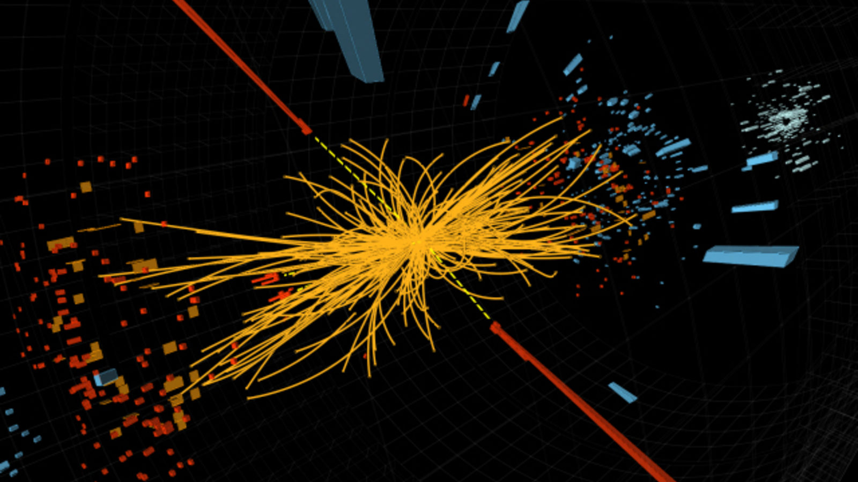
Higgs Boson Machine Learning Project
BY-
Dewang Vinchhi
Dheeraj Anikar
Kunal Shinde
Prayash Panda

Slide 2
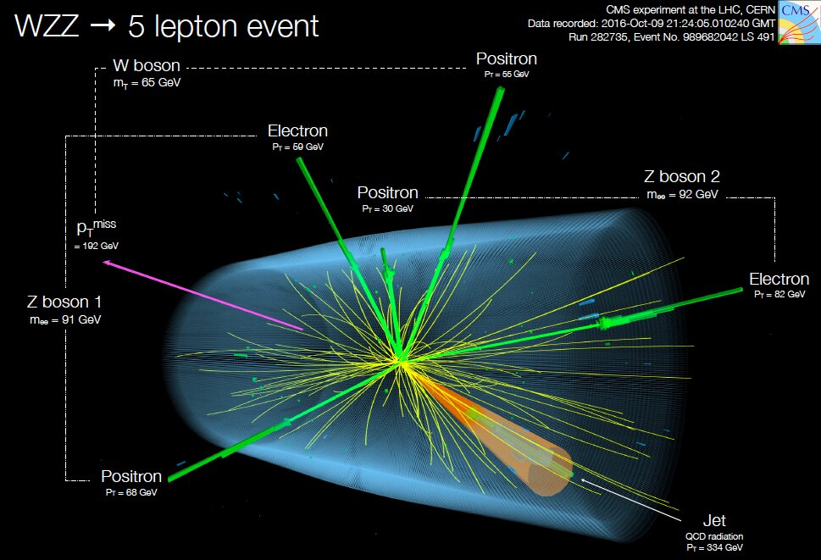
What is the Higgs Boson Challenge?
The ATLAS experiment at CERN provided simulated data used by physicists to optimize the analysis of Higgs Boson.
We are concerned with the identification of Higgs Boson decaying into tau-leptons pairs.
This naturally lends itself as a classification problem and we have used AMS i.e., Average Median Significance, as its evaluation metric.

Slide 3
Details of the Dataset
Our dataset has 2 types of Features:
1) Primitive Features- The raw data that has been measured by ATLAS
2) Derived Features - Data derived from these Primitive Features.
When a particle decays it resembles a jet. The jet value is the number of decayed particles. Thus, the column PRI_num_jet is a categorical feature. Accordingly the datasets have been split into 4 sub-sets.

Slide 4
Models Implemented
Logistic Regression
KNN Classifier
Decision Tree Classifier
Random Forest Classifier
Gradient Boosting to boost our models

Slide 5
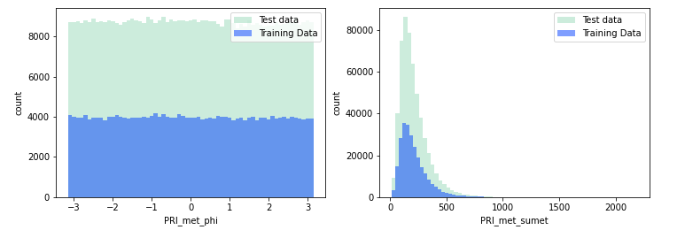
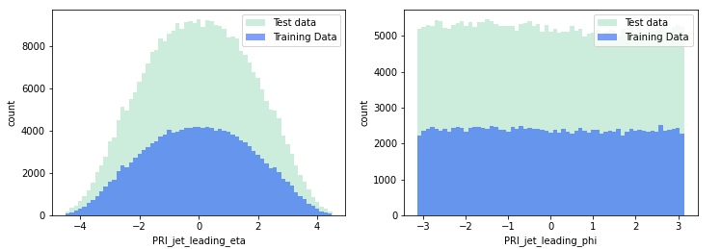
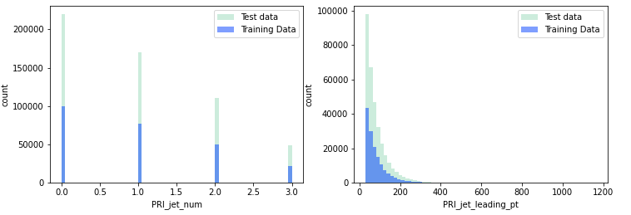
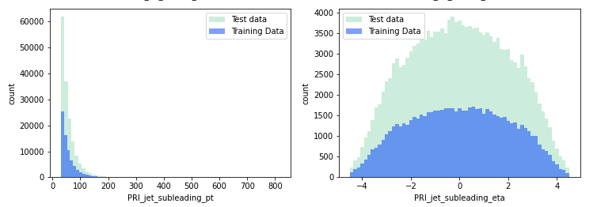
Observations
Skewed Distribution can be observed
Different range of values in different features.
-999 which were “meaningless” were replaced with NaN values and dropped in later Analysis.
Standard Scaling was also done.

Slide 6
Splitting into different Jets
So Lets mention what we have right now:
'y' sets of dataframe training sets
dict_keys(['y_jet0', 'y_jet1', 'y_jet2', 'y_jet3'])
'X' sets of dataframe training sets
dict_keys(['X_jet0', 'X_jet1', 'X_jet2', 'X_jet3'])
For test data we have Testing sets Dataframe only:
dict_keys(['test_ds_jet0', 'test_ds_jet1', 'test_ds_jet2', 'test_ds_jet3’])
Shape of training sets
- (59032, 19)
- (55986, 22)
- (37942, 29)
(16550, 29)
Shape of testing datasets are
- (162712, 19)
- (153003, 22)
- (104469, 29)
- (45994, 29)

Slide 7
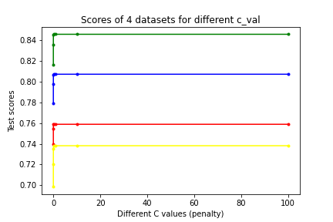
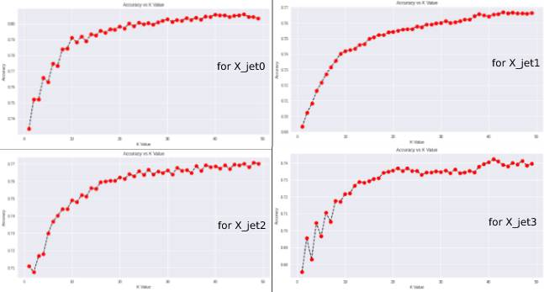
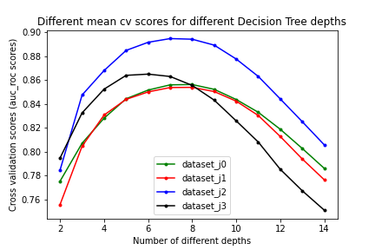
Further Analysis

Slide 8
RESULTS
ACCURACY TABLE
Model | X_jet0 | X_jet1 | X_jet2 | X_jet3 | Average accuracy
Logistic Regression | 79.03% | 69.26% | 72.59% | 72.00% | 73.22%
KNN Classifier | 80.58% | 76.68% | 77.06% | 74.22% | 77.135%
Decision Trees | 81.61% | 79.76% | 83.15% | 83.66% | 82.04%
AMS TABLE
Model | AMS
Logistic Regression | 0.5174
KNN Classifier | 0.5767
Decision Trees | 0.6031
RUN TIME
Model | Approx Run time
Logistic Regression | < 1 min
KNN Classifier | 3-4 hrs
Decision Trees | <15 min

Slide 9
HYPERPARAMTERS EVALUATION
C value for Logistic Regression
K Value for KNN
Decision Trees MAX_DEPTH using CV
X_jet0 | 0.1
X_jet1 | 0.1
X_jet2 | 10
X_jet3 | 100
X_jet0 | 46
X_jet1 | 43
X_jet2 | 48
X_jet3 | 41
X_jet0 | 8
X_jet1 | 8
X_jet2 | 7
X_jet3 | 6

Slide 10
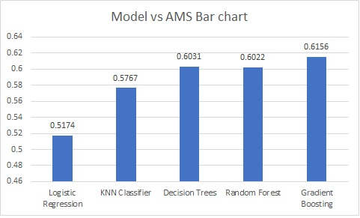
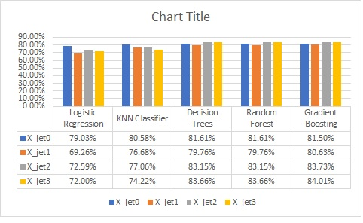
Results( Continued)
Model | X_jet0 | X_jet1 | X_jet2 | X_jet3 | Average accuracy
Random Forest | 81.61% | 79.76% | 83.15% | 83.66% | 82.05%
Gradient Boosting | 81.50% | 80.63% | 83.73% | 84.01% | 82.46%
Model | AMS
Random Forest | 0.6022
Gradient Boosting | 0.6156

Slide 11
CONCLUSION
The best accuracy is from Gradient Boosting.
Greater the AMS, better is our model.
Scope for Improvements
Use of complex Machine learning models like ANN or RNN
The iterations could be increased, but it depends on system configuration.
Addition of New features through Feature Engineering is also possible.

